Slide 1
Using JavaScript for Forms
CGI versus JavaScript Forms
The Form Object
Form Elements
Form Element Properties
Form Element Methods
Form Element Event Handlers
Form Validation

Slide 2
CGI versus JavaScript Forms
Creating forms with JavaScript doesn’t vary that much from creating forms with CGI.
The difference is the way in which data is entered and processed.
JavaScript performs some preprocessing before the form is submitted.
JavaScript can be used to partially check integrity of the data entered into forms.

Slide 3
The Form Object
Form object is used to access html form tags and properties through Javascript.
The elements of a form are stored in the Forms[] array, which is property of the Document object.
All the form elements are stored sequentially in the Forms array and can be accessed by their index number:
Document.Forms[0]

Slide 4
The Form Object
Consider a simple page:
<html>
<body>
<form>
<input type=“checkbox” Name=“ElementOne”>
</form>
<form>
<input type=“radio” Name=“ElementOne”>
<input type=“text” Name = “ElementTwo”>
</form>
</body>
</html>
In the above example Document.Forms[0] refers to the first form and Document.Forms[1] refers to the second form.

Slide 5
The Form Object
Document.Forms[1].Elements[0] is used to access the first element in the second form.
The properties of Form object are:
ACTION - Action is the name of the CGI script or application on the server that handles the form input.
ENCODING - refers to any special data encoding that might be passedto the server from script.
METHOD - refers to method used to communicate form data to the server, it can be either get or post.
TARGET - refers to the location where the form data is submitted.

Slide 6
Form Elements
Form elements have a number of associated properties, methods, and event handlers that can be used to customize the forms or to manipulate the data that is contained on the form.
Button
The button element represents a button on the current form. The button is created using <Input type=“button”> tag, and can be used to represent any action the user can execute on a page.
The onClick() event handler can be used to execute other functions or scripts when the button is pressed.

Slide 7
Form Elements
JavaScript Properties, methods, and events associated with the button element:
Properties : form, name, type, value
Methods : blur(), click(), focus()
Event Handlerrs : onblur(), onclick(), onfocus()
Html:
  <form>
  <input type=“button” value=“label” name=“name” onclick=“handler”>
  </form>

Slide 8
Form Elements
Checkbox Element
Checkbox can be used to select a single value, and is created using <Input type=“checkbox”> tag.
The onclick() event handler provides a mechanism for linking functions to the selection of a checkbox.
Properties : checked, defaultchecked, form, name, type, value
Methods : blur(), click(), focus()
Event Handlerrs : onblur(), onclick(), onfocus()
Html:
  <form>
  <input type=“checkbox” value=“label” Name=“name” Checked onclick=“handler”> </form>

Slide 9
Form Elements
Radio
Properties : checked, defaultchecked, form, name, type, value
Methods : blur(), click(), focus()
Event Handlerrs : onblur(), onclick(), onfocus()
Html:
  <form>
  <input type=“radio” value=“label” Name=“name” Checked onclick=“handler”> Label
  </form>

Slide 10
Form Elements
Select Element
The select element can take 2 forms: a single selection box, or, by using Multiple keyword, a multiple selection box.
Properties : form, length, name, options, selectedindex, type
Methods : blur(), click(), focus()
Event Handlerrs : onblur(), onclick(), onfocus()

Slide 11
Form Elements
Html:
  <form>
  <select name=“name” size=integer Multiple onchange=“handler” onblur=“handler” onfocus=“handlerr”>
  <option value=“value” Selected>option label
  <option value=“value”> option label
  </select>

Slide 12
Form Elements
Text Element
The text element is used to create a one-line text input field on the form.
The onchange() event handler can be used to invoke methods when text is entered into the field.
Properties : defaultValue, form, name, type, value
Methods : blur(), focus(), select()
Event Handlers : onblur(), onchange(), onfocus()
Html:
  <form>
  <input type=“text” name=“name” value=“default” size=integer>
  </form>

Slide 13
Form Elements
Submit Element
This button is used to submit the form data to a server application or cgi script for processing.
Properties : form, name, type, value
Methods : blur(), focus(), click()
Event Handlers : onblur(), onclick(), onfocus()
Html:
  <form>
  <input type=“submit” name=“name” value=“default” onclick=“handler”>
  </form>

Slide 14
Form Elements
Reset Element
This element provides users with a means of clearing any data entered into a form.
Properties : form, name, type, value
Methods : blur(), focus(), click()
Event Handlers : onblur(), onclick(), onfocus()
Html:
  <form>
  <input type=“reset” name=“name” value=“default” onclick=“handler”>
  </form>

Slide 15
Form Element Properties
Form - The form property represents the name of the current form.
Name - The name property represents the value of the name attribute specified in the html definition of the current form element.
<input type=text name=“address”>
Type - The type property represents the type of input element that has been defined in the current form.
Value - for form elements that have a data value that is going to be submitted, the value property represents that data.
Checked - the checked property is a Boolean that indicates the current status of a checkbox element.
Defaultchecked - the defaultchecked will return a true if the checkbox has been set to automatically be checkedd by using the checked keyword.

Slide 16
Form Element Properties
Options - The options property is an array that contains the values for all of the selection options that have been defined in the <select> tag.
Length - The length property represents the number of elements that are contained in the options array.
SelectedIndex - This property represents the array index number of the selected <option> element.
DefaultValue - The DefaultValue can be used to access the default text in elements.

Slide 17
Form Element Methods
There are 4 form element methods that can be invoked to change the status of form elements.
Blur() - The blur() method can be used to remove focus from a current element.
Click() - The click() method simulate a mouse click on a button or another element that generates an onclick event.
Focus() - When called it passes the user interface focus to that element, allowing the element to accept user input.
Select() - The select() method is used to select input elements that can be selected, such as text input fields, text areas, and so on.

Slide 18
Form Element Event Handlers
Onchange - The onchange event handler is used when the user enters data into a textfield or other element that contains data that can be changed.

Slide 19
Form Element Event Handlers
The event handlers are the methods that get called when a user interface event occurs.
For example, clicking a button generates an onclick event for that button.
Onblur() - onblur is the event handler calledd when the focus on a particular element is lost. It could be used to validate a field before progressing to the next.
Onclick() - The onclick event handler defines actions that should be performed when an element, such as a button, is clicked.
Onfocus() - The onfocus event handler is called when a form element receives user interface focus, for example, when a user clicks inside a textarea.

Slide 20
Validating Form Fields Using JavaScript
  <html> <head> <title>Form Validation Example</title>
  <script>
  function ValidateContactForm()
  {
  var name = document.ContactForm.Name;
  var email = document.ContactForm.Email;
  var phone = document.ContactForm.Telephone;
  var nocall = document.ContactForm.DoNotCall;
  var what = document.ContactForm.Subject;
  var comment = document.ContactForm.Comment;
  if (name.value == "")
  {
  window.alert("Please enter your name.");
  name.focus();
  }

Slide 21
Validating Form Fields Using JavaScript
  if (email.value == "")
  {
  window.alert("Please enter a valid e-mail address.");
  email.focus();
  }
if (email.value.indexOf("@", 0) < 0)
{
window.alert("Please enter a valid e-mail address.");
email.focus();
}
if (email.value.indexOf(".", 0) < 0)
{
window.alert("Please enter a valid e-mail address.");
email.focus();
}

Slide 22
Validating Form Fields Using JavaScript
if ((nocall.checked == false) && (phone.value == ""))
{
window.alert("Please enter your telephone number.");
phone.focus();
}
if (what.selectedIndex < 1)
{
alert("Please tell us how we can help you.");
what.focus();
}
if (comment.value == "")
{

Slide 23
Validating Form Fields Using JavaScript
window.alert("Please provide a detailed description or comment.");
comment.focus();
}
}
function EnableDisable(chkbx)
{
if(chkbx.checked == true)
{
document.ContactForm.Telephone.disabled = true;
}
else
{
document.ContactForm.Telephone.disabled = false;
}
}
</script> </head>

Slide 24
Validating Form Fields Using JavaScript
<body>
<form method="post“ name="ContactForm" onsubmit=“ValidateContactForm();">
<p>Name: <input type="text" size="65" name="Name"></p>
<p>E-mail Address: <input type="text" size="65" name="Email"></p>
<p>Telephone: <input type="text" size="65" name="Telephone"><br>
<input type="checkbox" name="DoNotCall"
onclick="EnableDisable(this);"> Please do not call me.</p>
<p>What can we help you with?
<select type="text" value="" name="Subject">
<option> </option>
<option>Customer Service</option>
<option>Question</option>
<option>Comment</option>
<option>Consultation</option>
<option>Other</option>

Slide 25
Validating Form Fields Using JavaScript
</select></p>
<p>Comments: <textarea cols="55" name="Comment"> </textarea></p>
<p><input type="submit" value="Send" name="submit">
<input type="reset" value="Reset" name="reset"></p>
</form>
</body>
</html>

Slide 26
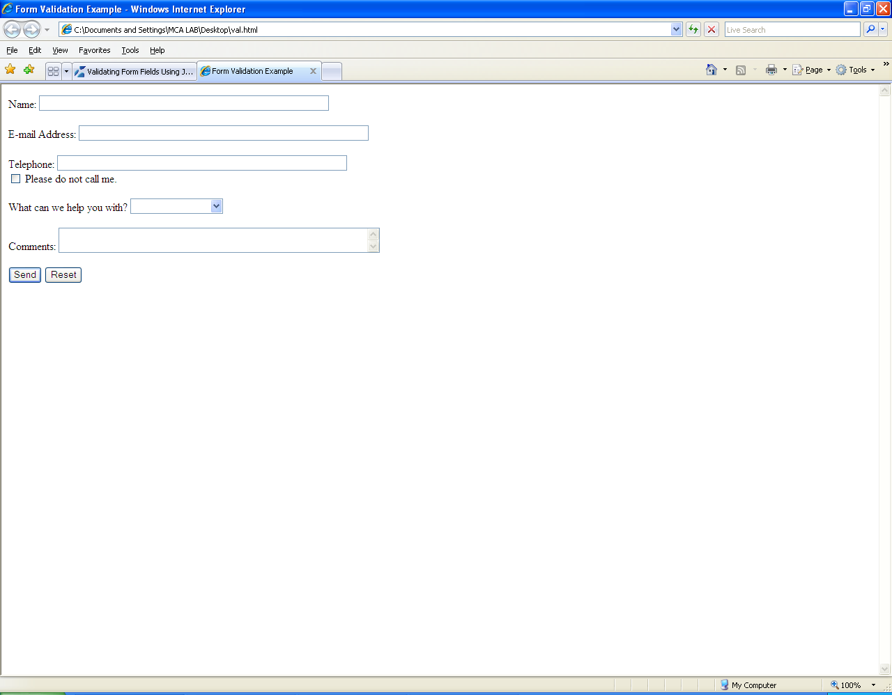
Validating Form Fields Using JavaScript

